Slide 1
GLASSDOOR Customer retention
Ashu Gowda

Slide 2
CUSTOMER RETENTION
The variation of a metric between the “RENEWED”contracts and “NOT RENEWED”contracts allows us to analyze data and make recommendations

Slide 3
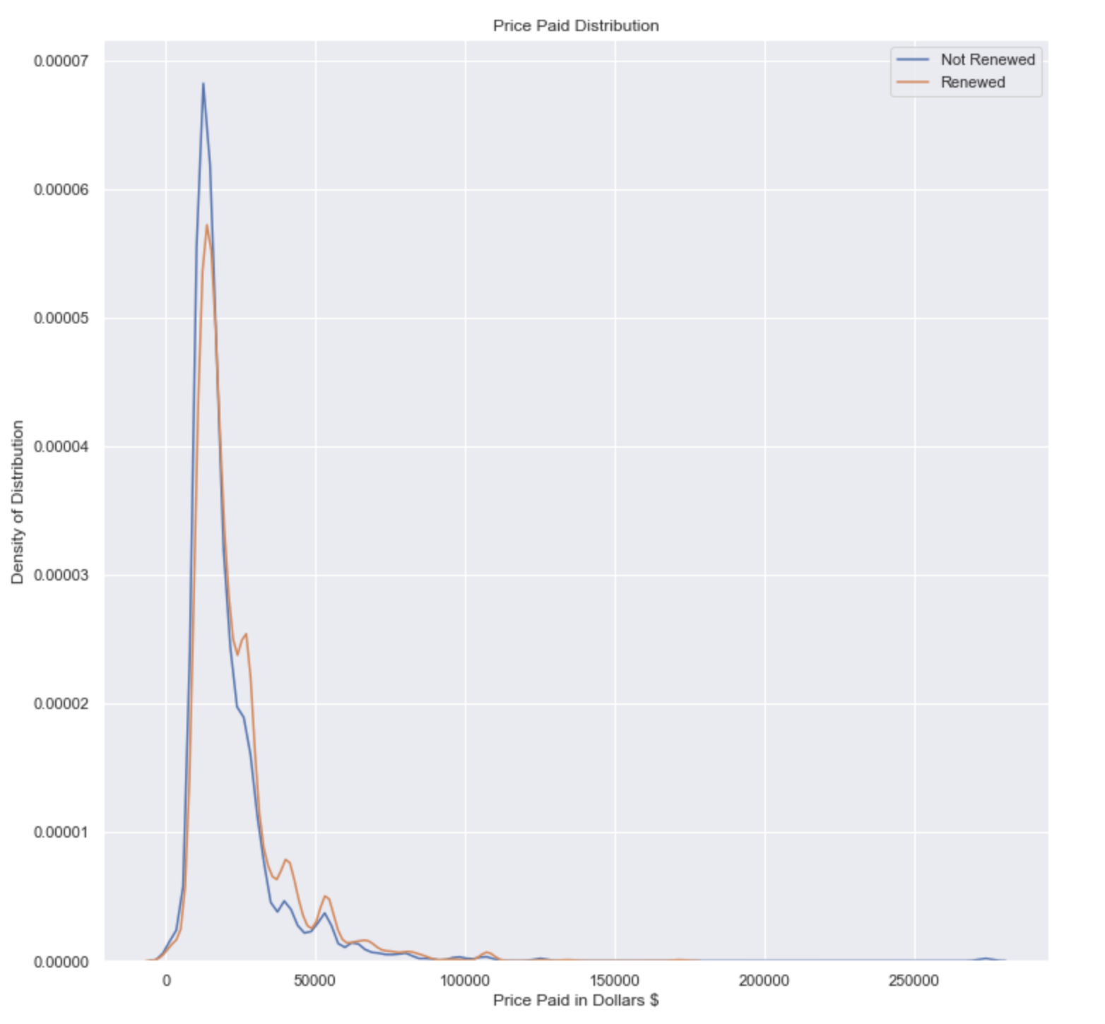
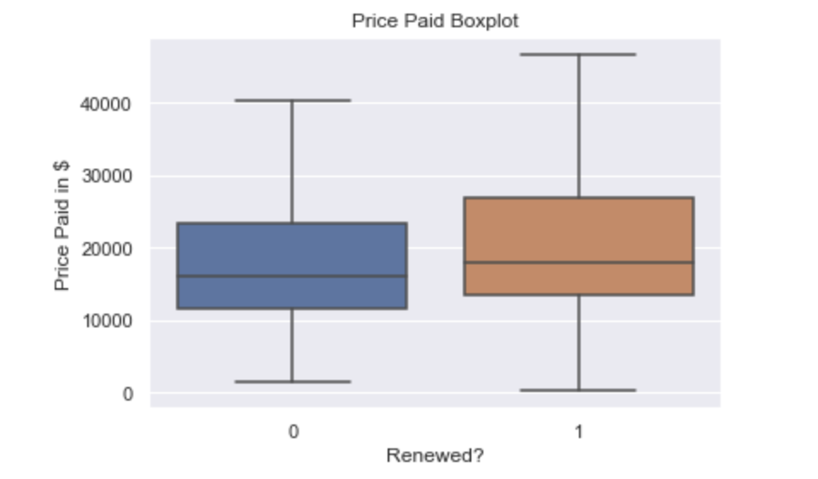
Variation BetWEEN “Renewed” contracts and “Not renewed” contracts
Distribution of Pricing

Slide 4
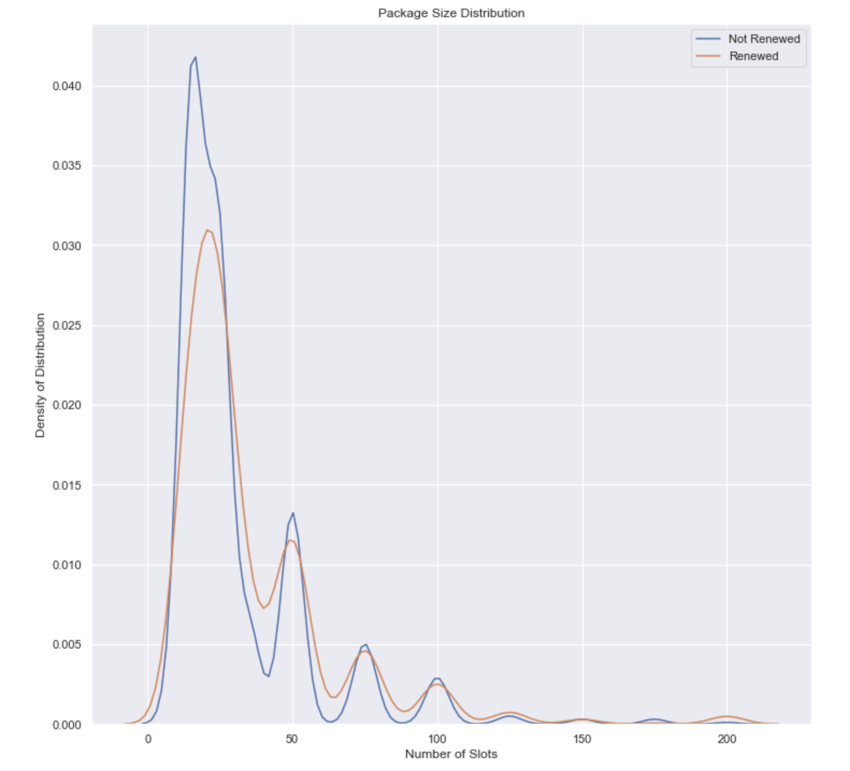
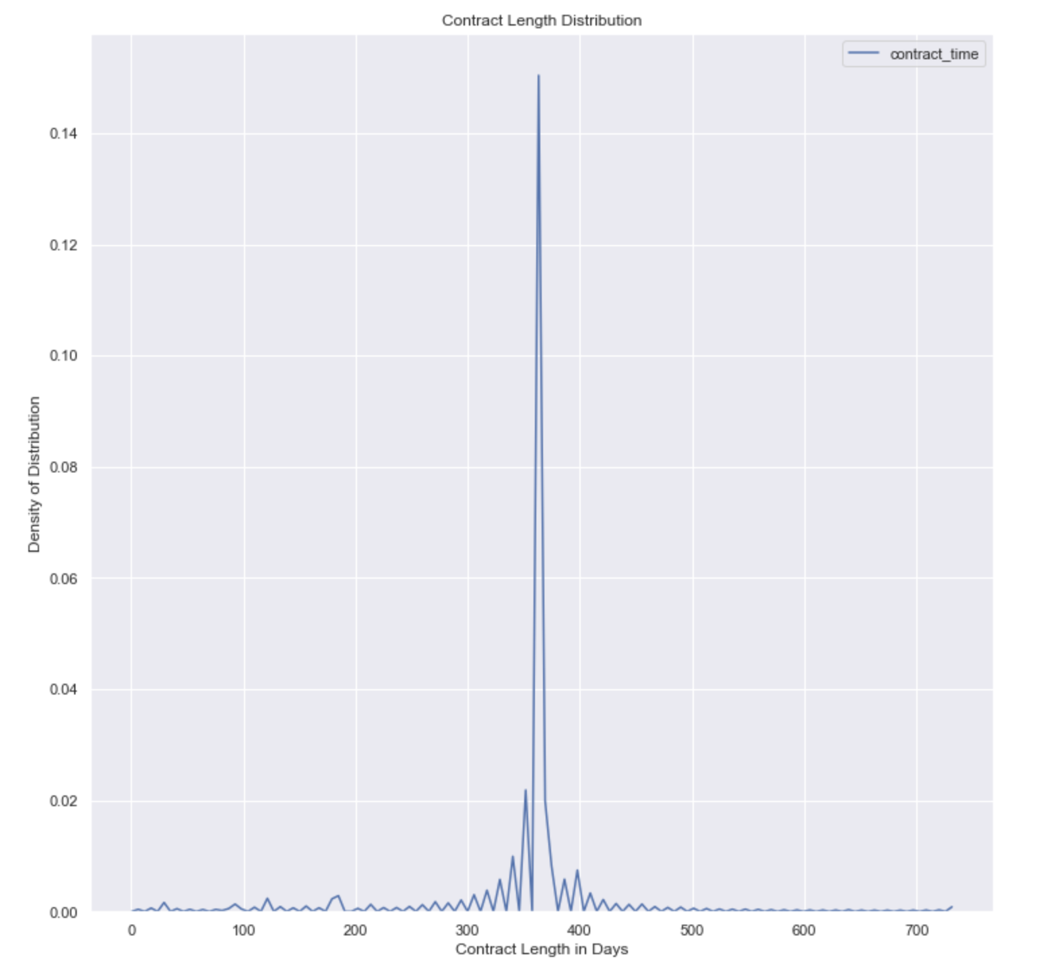
Variation BetWEEN “Renewed” contracts and “Not renewed” contracts
Slot Package Distribution
Contract Length Variation

Slide 5
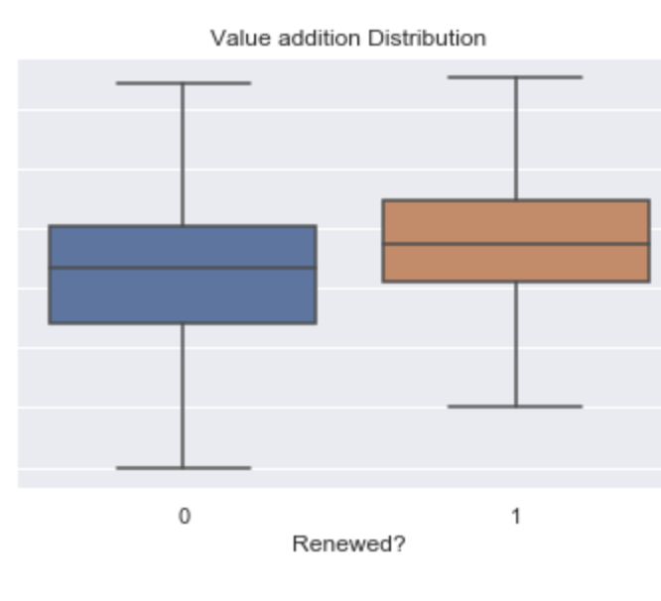
Performance measurement metric
Market Value Delivered – Price Paid = Value Addition

Slide 6
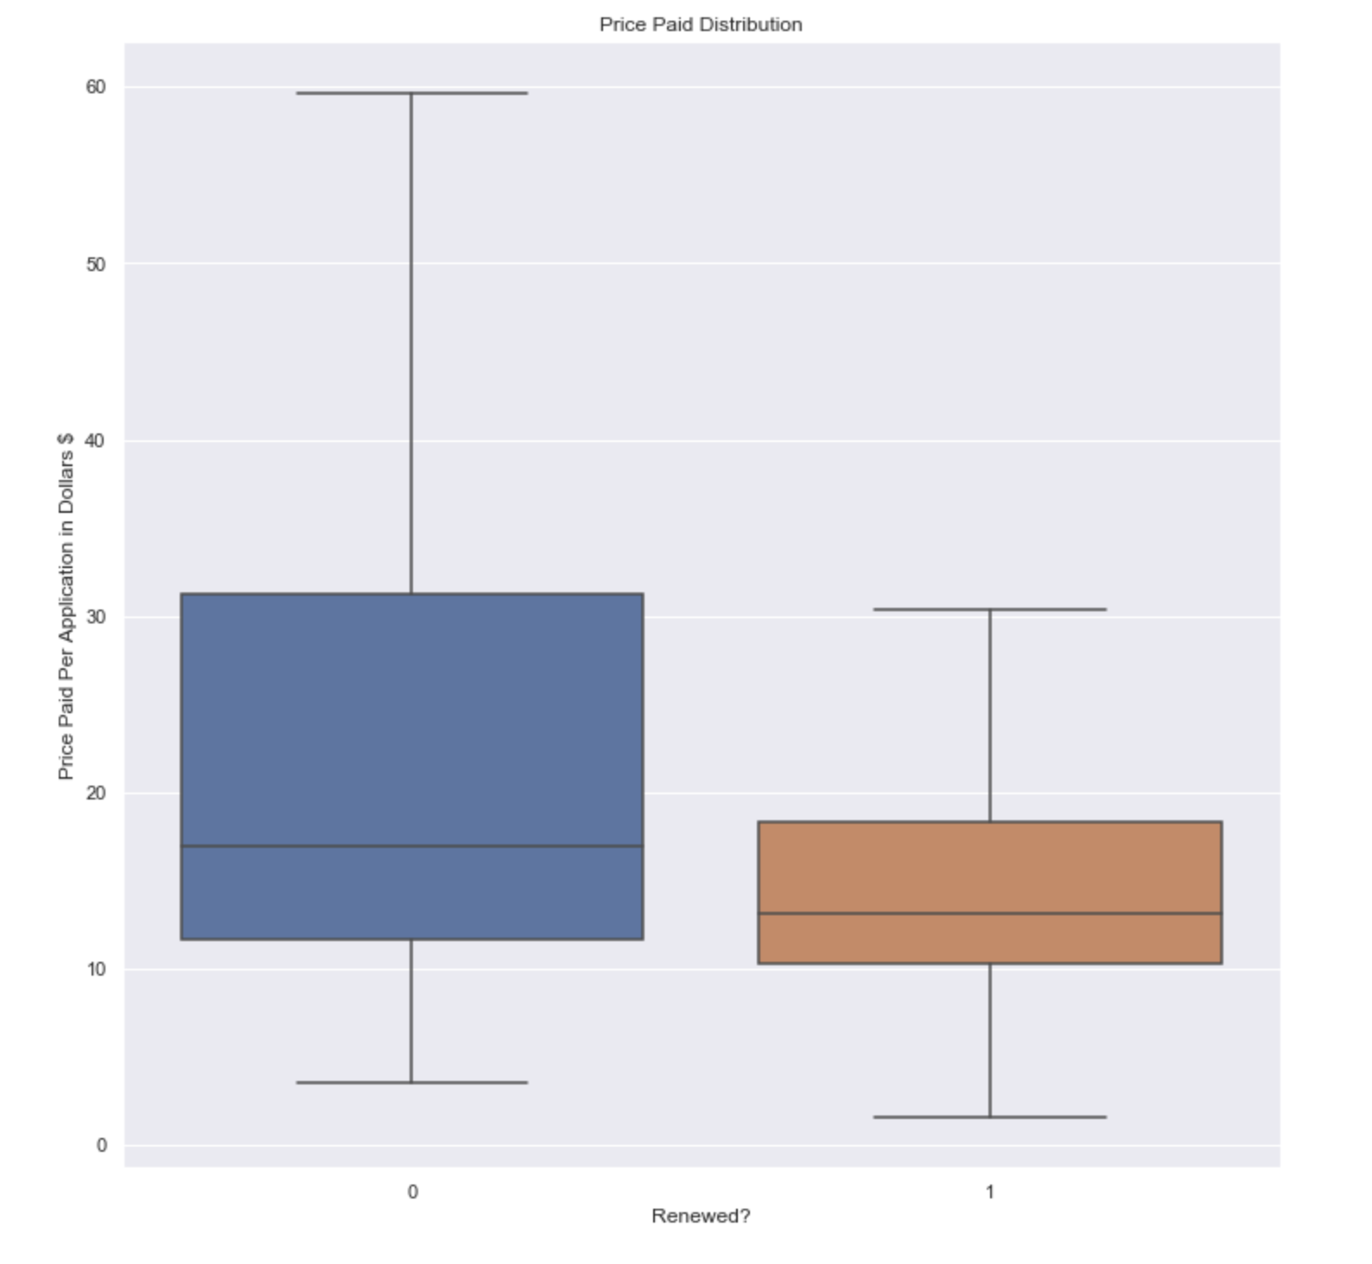
Performance measurement metric
Price Paid Per Application

Slide 7
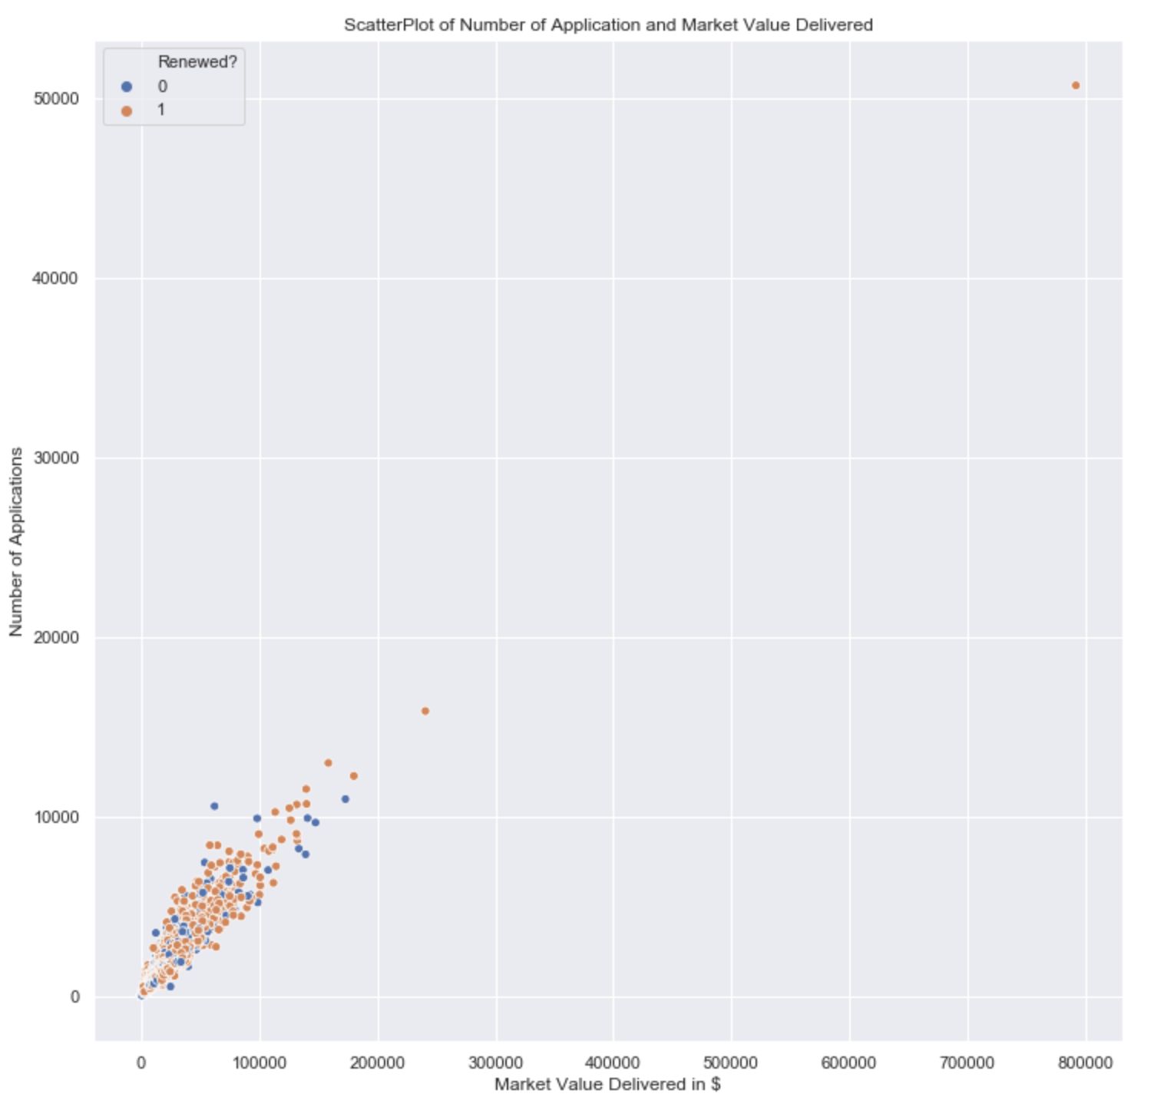
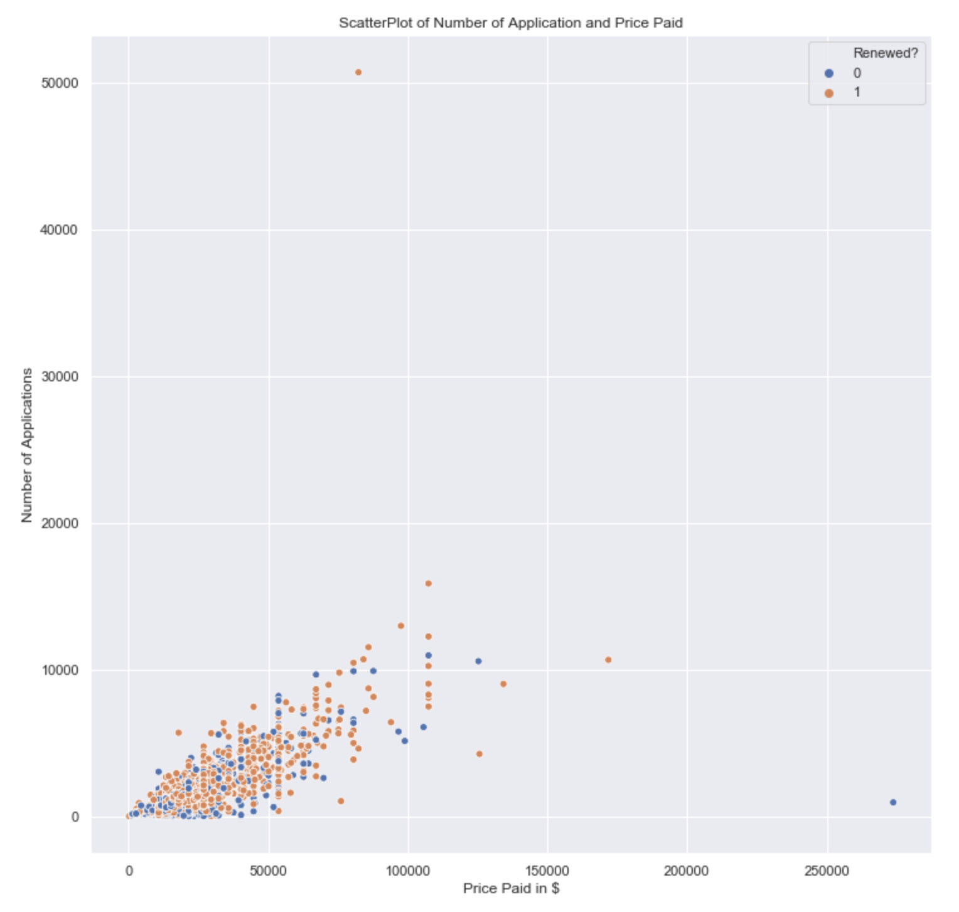
Variation BetWEEN “Renewed” contracts and “Not renewed” contracts
Market Value Delivered
v/s
Number of Application
Price Paid
v/s
Number of Application

Slide 8
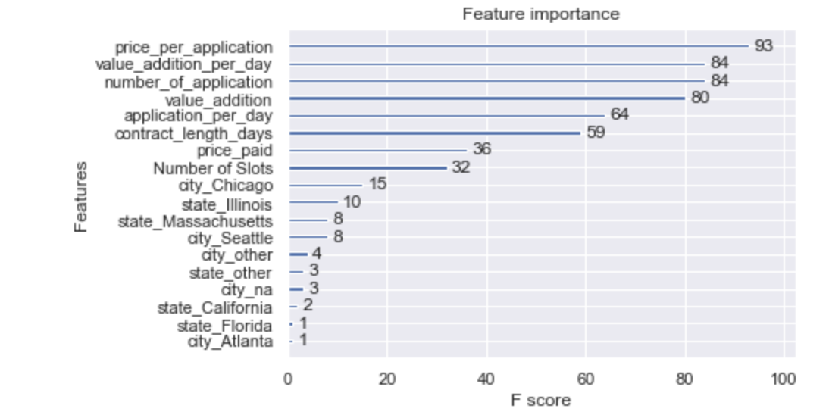
Factors to predict retention
Intuitive features were engineered. Example :
price_per_application
value_addition = price_paid – market_value_delivered
Value_addition_per_day
Classifiers like XGBoost Algorithm can give you important features which rank the factors which bring out highest variation between “RENEWED”contracts and “NOT RENEWED”contracts
“PRICE PER APPLICATION”, “VALUE ADDITION PER DAY” and “NUMBER OF APPLICATION” seem to be the most important factors

Slide 9
Retention prediction results
The Features Engineered from the previous step was modelled to fit to the label of “RENEWED” contracts and “NOT RENEWED” contracts
2 tree based and 1 linear model was used to compare 1st draft results
Model | Label | Precision | Recall | F1-score
Gradient Boost | NOT RENEWED | 0.62 | 0.25 | 0.35
 | RENEWED | 0.72 | 0.93 | 0.81
XGBoost | NOT RENEWED | 0.66 | 0.23 | 0.34
 | RENEWED | 0.72 | 0.94 | 0.82
Logistic Regression | NOT RENEWED | 0.46 | 0.41 | 0.44
 | RENEWED | 0.73 | 0.65 | 0.65
Tree-based models identifying “RENEWED recall” and “NOT RENEWED precision” well.
Linear Model identifying “NOT RENEWED recall” well.
A clever ensemble can be used as required by the application

Slide 10
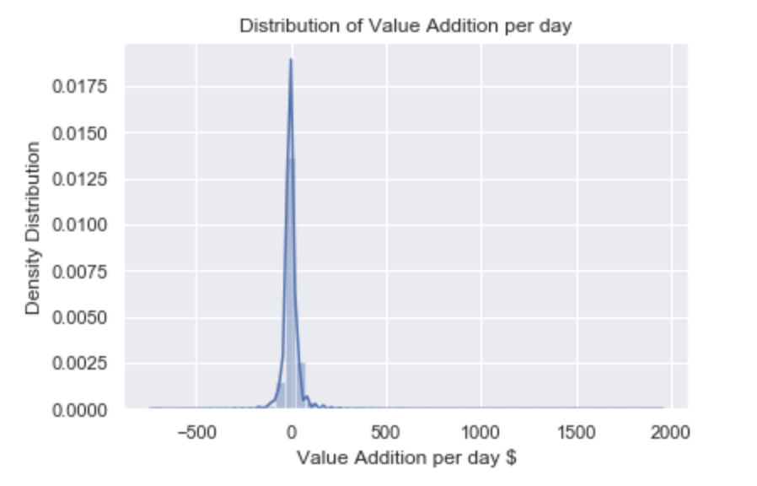
Recommendations
TO THE AD PLATFORM
Some contracts get over fulfilled, and some get under fulfilled; Optimization here could free up precious ad placement currently servicing over fulfilled contracts
TO IMPROVE ANALYSIS
How City and State affect the variations
Current data isn’t big enough or granular enough to understand the variation of this very important factor
Data Points which show the churn transition
Lack of sufficient data point which show how a customer churns; this could be vital for better recommendation
How Rate of the applications per day through the contract affect the variations
Helps in understanding customer behaviour

